Slide 1
The Internet of Things with Azure Cloud Services
Ian Hollier
Principal Software Engineer @ Microsoft Corp.

Slide 2
All the code and this presentation can be found here:
https://github.com/firedog1024/IoT123

Slide 3
What is the Cloud? (a look back through history)
The Cloud
On premise solutions
Computing Power
Increasing
Total cost per computing unit
Decreasing

Slide 4
What is IoT?
(Internet of Things)
The Cloud
Data sent over the Internet
(WiFi, Cellular, Bluetooth gateways)
Device
Device
Device
Device
Device
Device
Device
Device
Things
Device
Device
Device
Device
Device
Device
Device
…

Slide 5
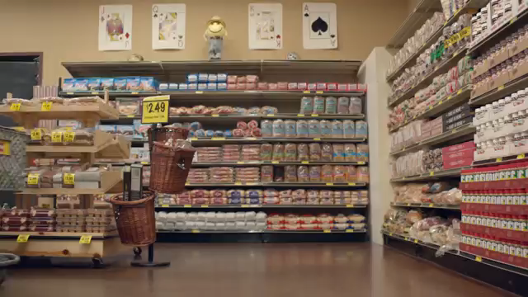
Why do we combine IoT and the Cloud?

Slide 6
What are these IoT devices?
Embedded Systems
- Realtime OS (ROS)
- <512KB RAM
- Limited storage
- Limited I/O
- Installed in a product
System on a Chip
- Linux Kernel OS
- >1GB RAM
- Large storage
- Extensive I/O
Gateway Devices
- Linux/Windows OS
- >4GB RAM
- Large storage
- Extensive I/O
- Multiple communication protocols

Slide 7
What are we building today?
Azure Cloud
Temperature Data
In Fahrenheit
Device with Temperature Display
Temperature Data
In Centigrade
Device with Temperature Sensor

Slide 8
Data Flow
Azure IoT Hub
Azure Function
(convert Centigrade to Fahrenheit)
Azure IoT Hub
Device with Temperature Sensor
Device with Temperature Display
Service bus
Temperature in
centigrade
message
Temperature
in centigrade
JSON data
Temperature
in fahrenheit
JSON data
Temperature in
fahrenheit
message

Slide 9
The Raspberry Pi Zero W
1GHz, single-core CPU
512MB RAM
Mini HDMI and USB On-The-Go ports
Micro USB power
HAT-compatible 40-pin header
Composite video and reset headers
CSI camera connector
802.11 b/g/n wireless LAN
Bluetooth 4.1
Bluetooth Low Energy (BLE)

Slide 10
Other things used
DHT11 basic temperature-humidity sensor
Pimoroni Micro Dot pHat

Slide 11
Lets write some code ☺

Slide 12
Resources
Student access to Azure Services:
https://azure.microsoft.com/en-us/pricing/member-offers/imagine/
Azure IoT sdk
https://github.com/azure/azure-iot-sdks
Azure portal
https://portal.azure.com
Office 365 for students
https://products.office.com/en-us/student/office-in-education

Slide 13
Questions?
Feel free to ask me questions about anything (IoT, Azure, Microsoft, working in the software industry, etc). However I reserve the right to not always answer ☺

